Slide 1
Compilers are from Mars,
Dynamic Scripting Languages are from Venus
Jose Castanos, David Edelsohn, Kazuaki Ishizaki, Priya Nagpurkar, Takeshi Ogasawara, Akihiko Tozawa, Peng Wu

Slide 2
Motivation
DSL languages offer quick and simplified prototyping and a significant boost of programming productivity
  Growing frameworks to simplify development and deployment: Rails (Ruby), Django and Zope (Python)
DSL languages are steadily gaining popularity and starting to be seen in emerging server application domains
  Cloud: Google AppEngine, Amazon EC2
  Web 2.0: FaceBook (PHP), YouTube (Python), Twitter (Ruby)
Optimization of DSL programs is an active area of work
  Renewed browser wars

Slide 3

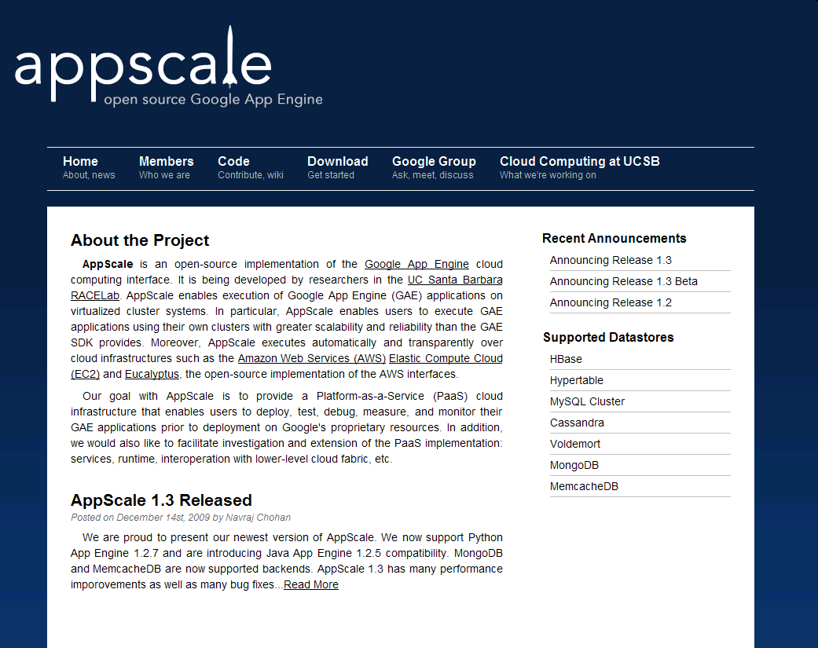

Slide 4
But …
Significant slowdown compared to equivalent C and Java
  Large penalty from dynamic features only occasionally exercised
Many different approaches and philosophies being evaluated
  New spin on old ideas (tracing, SELF, GC, …)
  Reluctance to publish
  A lot of variability on results
  Lack of agreed principles in the community
    i.e. no Dragon book

Slide 5
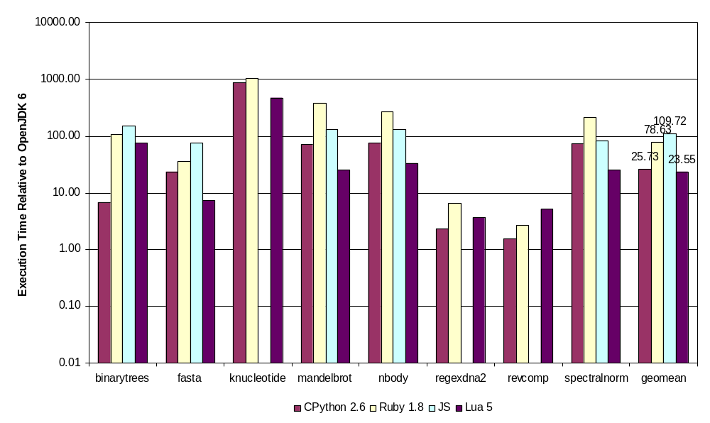
DSL Interpreter Performance

Slide 6
Barriers for Optimizations
Preserve language semantics
  Reflection, Introspection, Eval
  External APIs
Interpreter consists of short sequences of code
  Prevent global optimizations
  Typically implemented as a stack machine
Dynamic, imprecise type information
  Variables can change type
  Duck Typing: method works with any object that provides accessed interfaces
  Monkey Patching: add members to “class” after initialization
DSL flexibility largely given by dictionaries and associative arrays
  Constant lookups of builtins, methods, attributes, …
Memory management and concurrency
Function calls through packing of operands in fat object

Slide 7
Basic Optimization Approaches
Tracing
More precise type information through specialization
  Profiling
Optimistic optimizations protected by guards
  Insert checks in the generated code before the optimization
  Watches: intercept changes to (global) structures
Remove redundant lookups
  Do not treat constants as variables
  Caching
  Hidden classes/maps
Boxing/Unboxing
…

Slide 8
Python Compilers
Jython 2.5.1
  “Python over the JVM”; written in Java
  Open source effort, compatible with Python 2.5
  Similar approaches: JRuby, Rhino, …
IronPython 2.6
  “Python over CLR/DLR”; written in C#
  Open source effort led by Microsoft, Apache License V2
  Similar approaches: JRuby, Jscript, some VBasic?
  Mono for Linux, Silverlight for running inside the browser
Unladen Swallow compiler
  “Extend the standard CPython interpreter with the LLVM JIT”
  Open source effort led by Google,
  Current version based on Python 2.6, merged into standard Python 3.2 release
    http://www.python.org/dev/peps/pep-3146/
  Similar approaches: Rubinius, …
PyPy 1.3
  “Python on Python”
    Actually, compiler and interpreter are written on RPython (a restricted version of Python with types) and some generated C code
  Open source effort (evolution of Psycho)
  Tracing JIT; PYPY VM/JIT can target other languages

Slide 9
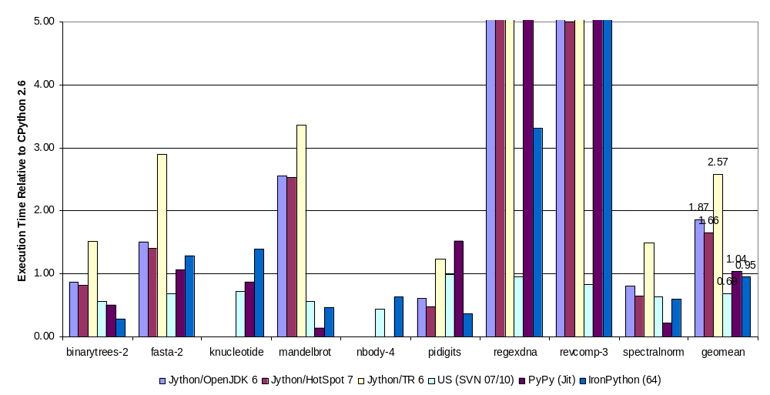
Shootout Python

Slide 10
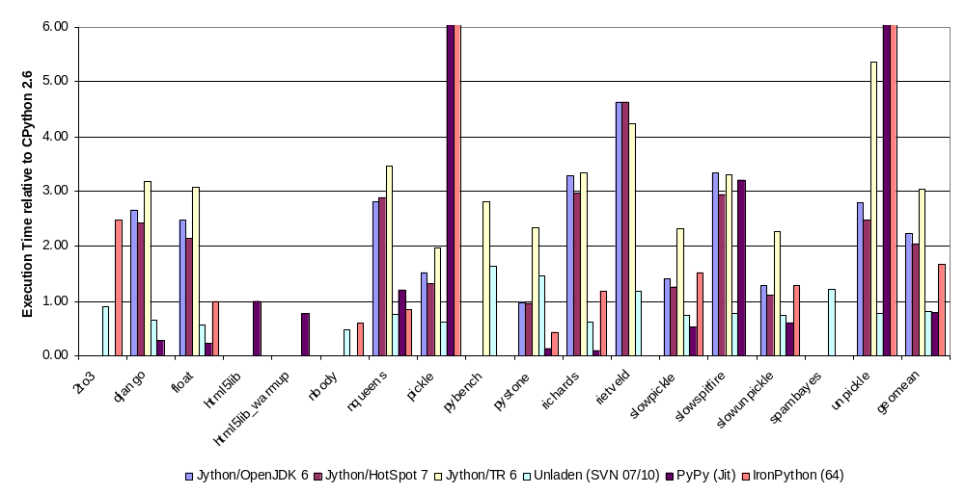
Unladen Swallow Benchmark

Slide 11
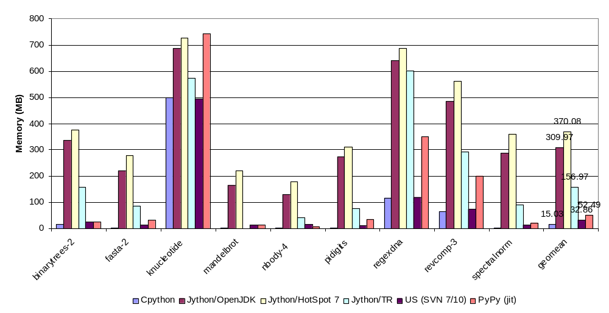
Memory Considerations
Low memory consumption is important on DSLs
  Parallelism at the script level
  Multiple instances of the same script

Slide 12
Jython
“All the restrictions in Java are in the Java language, not on the JVM. The JVM is language independent.”
  Types need to match in function calls
    InvokeDynamic (JSR 292) prototyped in Da Vinci Machine and part of Java 7
Clean implementation of Python on top of the JVM
  Based on Python 2.5
    Several US benchmarks fail with reserved word ‘with’
Generate JVM bytecodes from Python programs
  No python interpreter, just Java interpreter
Interface with Java programs; cannot easily support standard C modules
  Runtime written in Java, so JIT can optimize between user programs and runtime
Wrap around Python types java class hierarchy
  Permits function specialization based on types
Relies on Java’s GC
Better support for multithreading
  Container classes like dictionaries, etc. are thread safe

Slide 13
Inlining in Jython
Benchmark |  | binarytrees | nqueens | slowspitfire
Function |  | check_treee | permutations | main
Python Bytecodes |  | 21 | 144
Initial IR | Nodes | 186 | 1059 | 510
 | Basic Blocks | 5 | 21 | 9
Cold | Nodes | 494 | 3918 | 1565
 | Basic Blocks | 39 | 237 | 96
 | Inline Sites (depth) | 8 (4) | 68 (3) | 27 (5)
Warm | Nodes | 1936 | 5017 | 7692
 | Basic Blocks | 125 | 253 | 550
 | Inline Sites( depth) | 18 (10) | 35 (11) | 91 (11)
Hot | Nodes |  | 15056
 | Basic Blocks |  | 840
 | Inline Sites (depth) |  | 142 (16)
Very Hot | Nodes | 43811 | 12826 | 40629
 | Basic Blocks | 3014 | 889 | 2654
 | Inline Sites (depth) | 173 (12) | 281 (17) | 178 (11)
Scorching | Nodes | 26190 | 20611 | 27530
 | Basic Blocks | 1904 | 1318 | 1878
 | Inline Sites (depth) | 176 (12) | 203 (18) | 177 (11)

Slide 14
Java Methods Compiled by the JIT
Number of Java methods and methods corresponding to user code compiled by optimization level
 | Shootout |  | US Benchmark
 | Total | user python code | Total | user python code
cold | 3824 | 20 | 14222 | 89
warm | 3553 | 19 | 10816 | 91
hot | 122 | 10 | 868 | 74
very-hot | 75 | 12 | 532 | 81
scorching | 30 | 6 | 72 | 12

Slide 15
IronPython
Microsoft developed DLR (largely improved in .Net 4.0) to facilitate the development of scripting languages on top of CLR
  .Net modules Microsoft.Dynamic, Microsoft.Scripting
  DLR provides easy interoperability between all the .Net languages, call site caching (DynamicSites) and general purpose expression trees
IronPython written in C#, with a C# Python runtime, on top of DLR
First step is to create a Python specific AST
Bind and translate the Python AST to a CLR AST and perform standard CLR optimizations and code generation
  Cache runtime checks for undefined types through DynamicSites mechanism
Method based compiler
  No interpreter
  CIL generation at function definition time
Uses CLR object model (wrappers for Python objects) and standard CLR garbage collection

Slide 16
DynamicSites in IronPython
CLI for result=result+val
.method private static object fioranoTest$1(class [IronPython]IronPython.Runtime.PythonFunction $function, object size, object val) cil managed
{
.maxstack 16
.locals init (
[0] class [IronPython]IronPython.Runtime.CodeContext $globalContext,
[1] object x,
[2] object result,
[3] int32 $lineNo,
[4] bool $lineUpdated,
[5] bool flag,
[6] class [System.Core]System.Runtime.CompilerServices.CallSite`1<class [mscorlib]System.Func`4<class [System.Core]System.Runtime.CompilerServices.CallSite, object, object, bool>> $site,
[7] object obj2,
[8] class [mscorlib]System.Exception $updException)
…
L_0055: ldsfld class [System.Core]System.Runtime.CompilerServices.CallSite`1<!0> [IronPython]IronPython.Compiler.Ast.SiteStorage000`1<class [mscorlib]System.Func`4<class [System.Core]System.Runtime.CompilerServices.CallSite, object, object, object>>::Site001
L_005a: ldfld !0 [System.Core]System.Runtime.CompilerServices.CallSite`1<class [mscorlib]System.Func`4<class [System.Core]System.Runtime.CompilerServices.CallSite, object, object, object>>::Target
L_005f: ldsfld class [System.Core]System.Runtime.CompilerServices.CallSite`1<!0> [IronPython]IronPython.Compiler.Ast.SiteStorage000`1<class [mscorlib]System.Func`4<class [System.Core]System.Runtime.CompilerServices.CallSite, object, object, object>>::Site001
L_0064: ldloc.2
L_0065: ldarg.2
L_0066: callvirt instance !3 [mscorlib]System.Func`4<class [System.Core]System.Runtime.CompilerServices.CallSite, object, object, object>::Invoke(!0, !1, !2)
L_006b: stloc.2
First time we reach the call site, the runtime will check the arguments and generate a stub depending on the argument types
  Code generated by the IronPython AST classes; call site maintains a reference to the Python AST nodes
IronPython AST classes also generate guards so future invocations can check the guards without requiring to call back into IronPython unless arguments change
  In shootout, 1700 call into the IronPython runtime to generate stubs, mostly at initialization time
Most IronPython AST classes implement this mechanism
  Not just unary and binary operations, but control flow, function calls, etc.
DLR provides a caching mechanism to support several types/stubs (L1, L2, …) in one call site
No specialization on the user program
  Specialization inside the guarded code
  No high level analysis that optimizes across call sites

Slide 17
Unladen-Swallow Compiler
As extension to CPython, uses same CPython object model
  CPython objects implemented as C structs with pointers to functions that implement specific object behavior
    Extensive casting
  Memory management through reference counting
    At Gen IL time, remove some inc/dec pairs
  Because it preserves the CPython semantics, large amount of the generated code required to preserve exceptions
  Transparent integration with all C module extensions of Python
  Suffers from the same concurrency problems because of the GIL
Relies on CPython interpreter for initial processing of a function
  Only “hot” functions are compiled with LLVM
Method based compiler
  Once Ptyhon function is declared hot, generates LLVM IR and calls LLVM to compile the function
  LLVM handles binary buffers and function linking
US modified CPython runtime to register Watches (out of line guards) on global structs (dictionaries)
  i.e. a source function changed makes the compiled code obsolete

Slide 18
Unladen-Swallow Compiler (II)
US implemented function call optimizations
  Function calls are very heavy in CPython, requiring building a self contained frame object
  CPython provides some optimizations to reduce the overhead of common calls
  US extended the checks for builtins, fixed arity functions, …
Later versions of US implement a runtime feedback profiler
  Standard CPython shortcircuits common types (i.e. ints) but disables in US
  Profiled types are: function calls, user level control flow, operand types
  If runtime information available, generate special version of code with guards
    Nevertheless, only one compiled version per Python code object

Slide 19
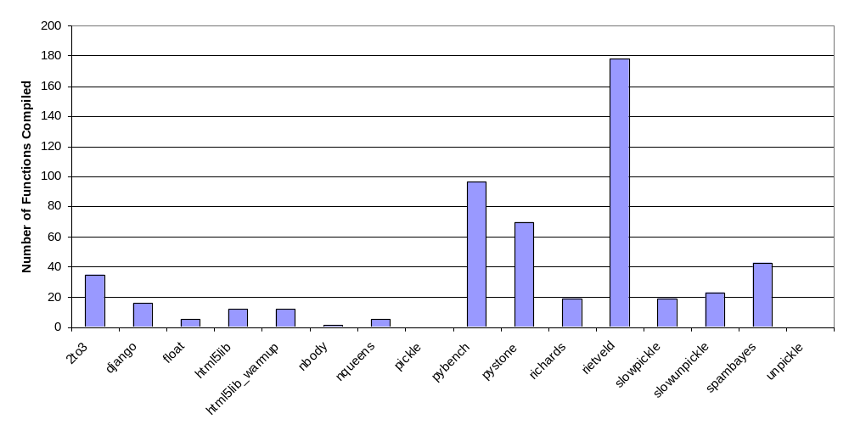
Unladen-Swallow Optimizations
Two LLVM strategies
  New Python specific analysis and optimizations
  All code seems to be compiled with hottest one
llvm::createCFGSimplificationPass
PyCreateSingleFunctionInliningPass
CreatePyTypeMarkingPass
llvm::createJumpThreadingPass
llvm::createPromoteMemoryToRegisterPass
llvm::createInstructionCombiningPass
llvm::createCFGSimplificationPass
llvm::createScalarReplAggregatesPass
AddPythonAliasAnalyses
llvm::createLICMPass
llvm::createJumpThreadingPass
AddPythonAliasAnalyses
llvm::createGVNPass
llvm::createSCCPPass
CreatePyTypeGuardRemovalPass
llvm::createAggressiveDCEPass
llvm::createCFGSimplificationPass
llvm::createVerifierPass
Relatively small number of functions compiled
  Just once (no cold->warm->hot passes)

Slide 20
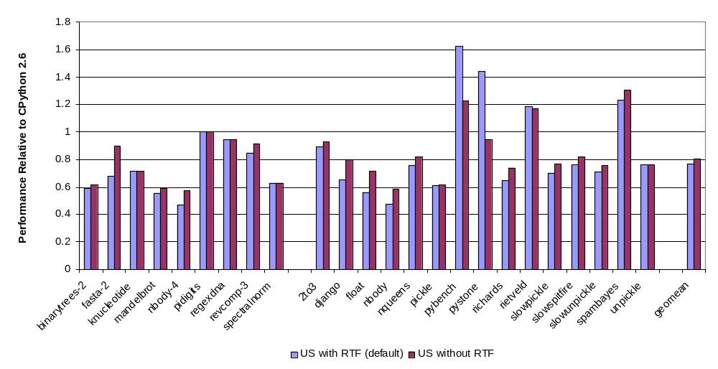
Unladen-Swallow: Effectiveness of Runtime Feedback

Slide 21
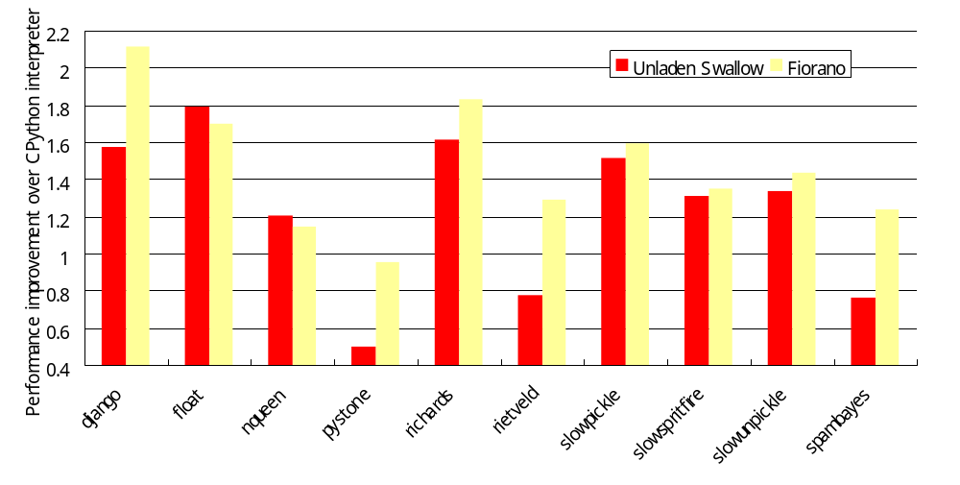
JIT Performance Improvement Comparison between Fiorano and Unladen Swallow
Over interpreter,
  Unladen Swallow improves performance by 32% on average
  Fiorano improves performance by 53% on average
Fiorano gets more
20% improvement
Higher is better
On Westmere 2.93GHz, RHEL 5.5

Slide 22
PyPy
Python compiler written in restricted version of Python (RPython)
  RPython allows static inference
  PyPy can run (slowly) on top of the Python interpreter
  More common use scenario is to translate the PyPy RPython code to a backend
    C (and then standalone binary executable), CLI (.Net), JVM
  Runtime also written in RPython
    High level python operations are automatically translated to low level C/CLI operations
PyPy contains
  A Python interpreter with the ability to collects traces
  A tracing JIT, derived from RPython
    Tracing of loops in the user level programs, but recording exact operations executed inside the interpreter
      i.e. records specific operations like int_add rather than generic operations like binary_add
      Includes guards
      Automatically provides specialization
    Currently handled well loops without multiple takes paths, but does not handle well generator functions and recursion
  Well defined points to enter and exit traces, and state that can be safely modified inside the trace
    Black hole interpreter to transfer control to the interpreter when guards fail in a trace

Slide 23
PyPy (II)
PyPy uses techniques similar to prototype languages (Self, V8) to infer offsets of instance attributes
Garbage collected
Can interface with (most) standard CPython modules
  Creates PyObject proxies to internal PyPy objects
Limited concurrency because of GIL
  Needs better support in container classes

Slide 24
PyPy Traces
[2bcbab384d062] {jit-log-noopt-loop
[p0, p1, p2, p3, p4, p5, p6, p7, p8]
debug_merge_point('<code object fioranoTest, file 'perf.py', line 2> #24 JUMP_IF_FALSE')
debug_merge_point('<code object fioranoTest, file 'perf.py', line 2> #27 POP_TOP')
debug_merge_point('<code object fioranoTest, file 'perf.py', line 2> #28 LOAD_FAST')
guard_nonnull(p8, descr=<ResumeGuardDescr object at 0xf6c4cd7c>)
debug_merge_point('<code object fioranoTest, file 'perf.py', line 2> #31 LOAD_FAST')
guard_nonnull(p7, descr=<ResumeGuardDescr object at 0xf6c4ce0c>)
debug_merge_point('<code object fioranoTest, file 'perf.py', line 2> #34 BINARY_ADD')
guard_class(p8, ConstClass(W_IntObject), descr=<ResumeGuardDescr object at 0xf6c4ce9c>)
guard_class(p7, ConstClass(W_IntObject), descr=<ResumeGuardDescr object at 0xf6c4cf08>)
guard_class(p8, ConstClass(W_IntObject), descr=<ResumeGuardDescr object at 0xf6c4cf74>)
guard_class(p7, ConstClass(W_IntObject), descr=<ResumeGuardDescr object at 0xf6c4cfe0>)
i13 = getfield_gc_pure(p8, descr=<SignedFieldDescr 8>)
i14 = getfield_gc_pure(p7, descr=<SignedFieldDescr 8>)
i15 = int_add_ovf(i13, i14)
guard_no_overflow(, descr=<ResumeGuardDescr object at 0xf6c4d0c8>)
p17 = new_with_vtable(ConstClass(W_IntObject))
setfield_gc(p17, i15, descr=<SignedFieldDescr 8>)
debug_merge_point('<code object fioranoTest, file 'perf.py', line 2> #35 STORE_FAST')
…
[2bcbab3877419] jit-log-noopt-loop}

Slide 25
PyPy Traces
 | # traces | Tot BC | Max BC | Tot Func | Max Func | Tot IR | Max IR
binarytrees | 13 | 643 | 243 | 15 | 2 | 714 | 313
fasta | 21 | 229 | 33 | 21 | 1 | 906 | 203
knucleotide | 9 | 103 | 24 | 9 | 1 | 328 | 97
mandelbrot | 15 | 188 | 54 | 15 | 1 | 277 | 110
pidigits | 4 | 326 | 122 | 22 | 9 | 626 | 376
regexdna | 12 | 573 | 112 | 20 | 5 | 1641 | 352
revcomp | 5 | 72 | 17 | 5 | 1 | 354 | 86
spectralnorm | 19 | 391 | 54 | 35 | 3 | 603 | 125
dango | 65 | 1290 | 86 | 93 | 5 | 5376 | 878
float | 19 | 445 | 49 | 29 | 3 | 959 | 156
html5lib | 240 | 12944 | 213 | 1056 | 17 | 14393 | 1173
html5lib_w | 341 | 17541 | 213 | 1425 | 19 | 18611 | 1179
nqueens | 37 | 442 | 53 | 37 | 1 | 1794 | 248
pickle | 184 | 15978 | 329 | 329 | 14 | 5084 | 736
pybench | 827 | 103090 | 767 | 1726 | 81 | 63169 | 2553
pystone | 26 | 1018 | 250 | 77 | 20 | 2673 | 643
richards | 79 | 2850 | 206 | 352 | 18 | 1130 | 342
slowpickle | 140 | 3300 | 253 | 248 | 15 | 3458 | 429
slowspitfire | 20 | 344 | 34 | 20 | 1 | 866 | 284
slowunpickle | 99 | 1194 | 86 | 148 | 6 | 1713 | 355
unpickle | 103 | 1965 | 304 | 176 | 23 | 9438 | 2553
Pybench fails
after 2 iters

Slide 26
Conclusions
Many ideas being implemented in the community
Many design decisions are triggered by business constraints rather than by technical reasons
  How desirable is to match the default implementation?
    Lack of standards
  How do you track rapidly evolving open source communities?
  How do you “scale” to new languages?
There’s not a single bullet
  Optimizations at a higher level with semantic information
  Across the runtime …

